Slide 1
Project Demo-
TrackLyze
Date : 07/11/24

Slide 2
Agenda
Project Overview
Core Features
Technology Stack
Architecture Overview
Project Timeline
Future Scope
Conclusion

Slide 3
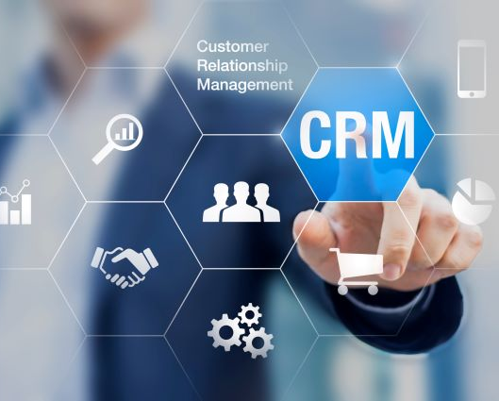
Project Overview
Goal:
Provides organization with comprehensive tools to track, manage, and visualize critical sales metrics and activities.
Objectives:
Offers real-time insights
Facilitates the management of client relationships
Enhanced Sales Visibility

Slide 4
Core Features
Admin Features:
Real-time metrics and data visualization.
Add salesrep and project manager.
Visual breakdown of leads,contacts,deals,accounts and projects.
Sales Representative Features:
Real-time metrics and data visualization.
Tracking of leads,deals,contacts and accounts.
Project Manager Features:
Real-time updates on client project statuses.
Visibility into project priorities, start and end dates, and project progression.
.

Slide 5

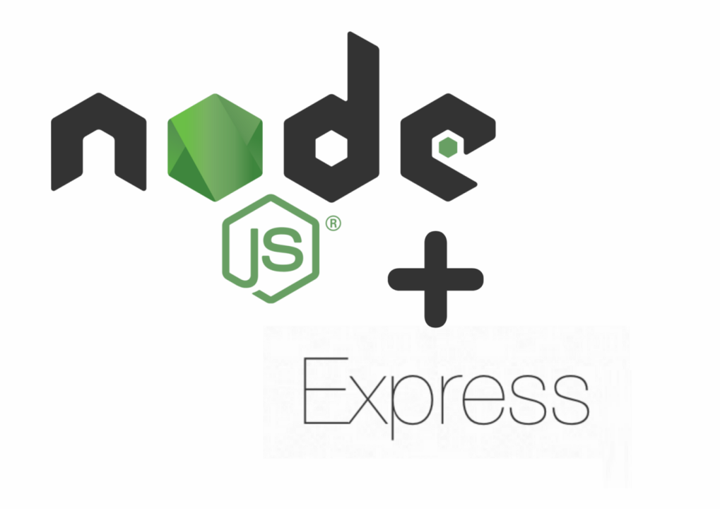

Technology Stack
Frontend:
React with TypeScript.
Backend:
Node.js and Express for REST APIs.
Database:
MongoDB for document-based storage.
Mongoose for schema modelling.
.

Slide 6
Architecture Overview
MERN Stack:
React (Frontend), Express + Node.js (Backend), MongoDB (Database).
Microservices:
User Service, Lead service, Contact service, Deal service, Account service, Project service & Metrics service.
Flow:
SalesRep, Project Manager and Admin authentication, session management, and role-based access control.

Slide 7
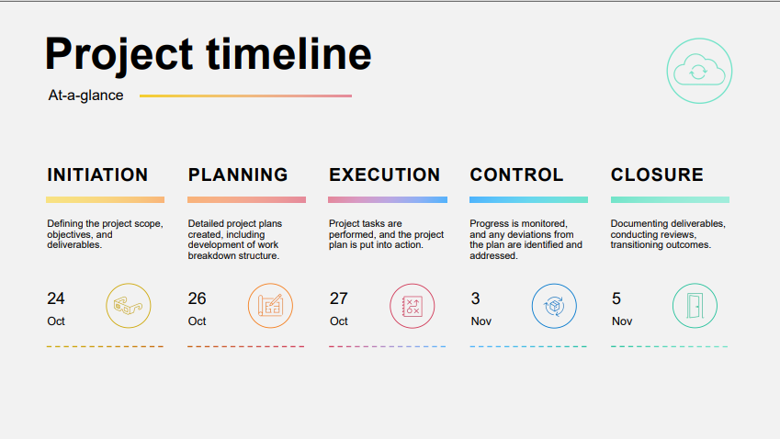

Slide 8

Application Demo
.

Slide 9
Future Scope
Automated Task and Workflow Management.
Advanced Reporting and Predictive Analytics.
Integration with External Communication.

Slide 10
Conclusion
Fulfills its primary purpose of enhancing organizational efficiency.
Improved User Experience and Productivity.
Scalable and Adaptable Foundation.

Slide 11
Thank You

